Slide 1
Front End and Backend Security With Keycloak, Transaction management and Model Classes implementation
Introduction:
In current scenarios vast amount of data is managed at basic level in different forms so loss of data is very dangerous and damaging . This will not only expose operations but also result in a great loss.
This presentation explains how you can leverage Keycloak to secure your Spring microservices.

Slide 2
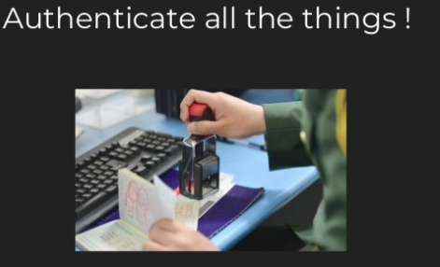

What is Keycloak?
Keycloak is a modern open source Identity and Access Management solution. It enables us to secure all sorts of frontend applications (apps) / services and offers the following features:
Single Sign-On
Identity Brokering and Social Login
User Federation
Client Adapters
Standard Protocols
Admin Console
User Account Management Console

Slide 3
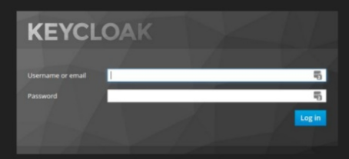
How It Works?
Image that there is already a Keycloak system setup in your organisation and you use it to secure your apps and services. Any unauthenticated user will be redirected to the Keycloak login page. After succesful login the user is redirected back to the application but with an additional authorization header. On this access the app only has to verify the token provided. When making calls to backend API services, frontend applications will need to provide the same authorization token in the request header. The backend service will use the information in the token to authenticate the user with keycloak and authorize access to endpoints.

Slide 4
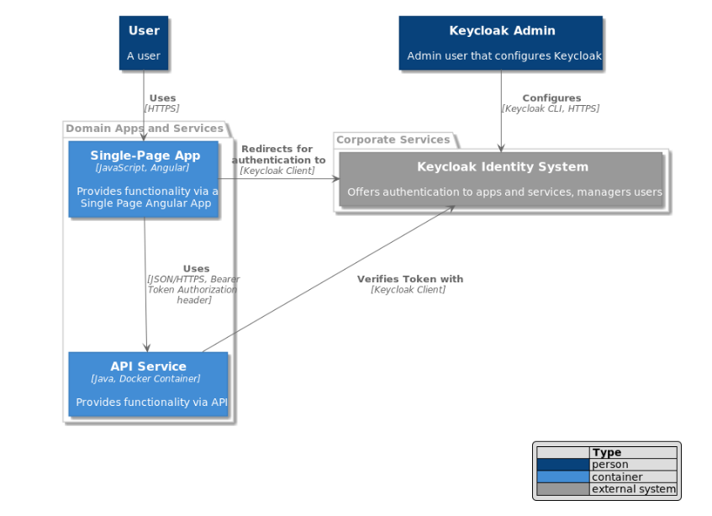

Slide 5

KeyCloak Additional Features:
Key Rotation
Random Key generation
One Time Password
Authorization Layer
Our Application Security
Use of Model classes (DTOs) to block access to entity classes and Database objects
Database transaction management and monitoring security
Keycloak (Tokenized) Authentication to block unauthorized access to our Spring boot Micro services
Keycloak (Tokenized) Authentication to block unauthorized access to Front end React application.
All unauthorized accesses will be blocked at gateway of microservices.
Regional Access via gateway i.e. only specific regions with implementation of microservices.

